Slide 1

UNIVERSITY INSTITUTE OF SCIENCES
Academic Unit V
Bachelor of Engineering (Computer Science & Engineering)
Biology For Engineers
23SZT-148
Statistical Analysis
DATA ACQUISITION
DISCOVER . LEARN . EMPOWER

Slide 2
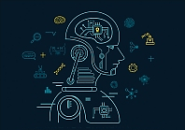

Course Outcome
CO Number | Title | Level
CO1 | To develop the firm foundation in science principles and higher level of understanding in each of the biology sub-discipline. | Remember
CO2 | To excel in career as researcher in both traditional and emerging fields of science . | Understand
CO3 | Understand ethical principles and responsibilities for science practices in society. | Understand
CO4 | To learn the new areas of biology for contemporary research with interdisciplinary approach | Understand
Will be covered in this lecture
https://images.app.goo.gl/5obqqxo93P2UBmdU6

Slide 3
SYLLABUS
Unit-2 | Biosensors and measurement system | Contact Hours: 15
Chapter 1 Medical Instrumentation Chapter 2 Measurement System Chapter 3 Biological Sensor | Medical Instrumentation: Sources of biomedical Signals, Basic medical Instrumentation system, Performance requirements of medical Instrumentation System, Microprocessors in Medical instruments, PC base medical Instruments, General constraints in the design of medical Instrumentation system, Regulation of Medical Devices. Measurement System: Specification of instruments, Statics & Dynamic characteristics of medical instruments, Classification of errors. Statistical analysis, Reliability, Accuracy, Fidelity, Speed of responses, Linearization of technique, and Data Acquisition System. Biological sensors: Sensors/ receptors in the human body, basic organization of the nervous system- neural mechanism, Chemoreceptor: hot and cold receptors, sensors for smell, sound, vision, Ion exchange membrane electrodes, enzyme, glucose sensors, immunosensors, & biosensors & applications of biosensors.

Slide 4
Statistical Analysis

Slide 5
Statistical analysis means investigating trends, patterns, and relationships using quantitative data.
It is an important research tool used by scientists, governments, businesses, and other organizations.
To draw valid conclusions, statistical analysis requires careful planning from the very start of the research process.
You need to specify your hypothesis and make decisions about your research design, sample size, and sampling procedure.
After collecting data from your sample, you can organize and summarize the data using descriptive statistics.
Then, you can use inferential statistics to formally test hypotheses and make estimates about the population.
Finally, you can interpret and generalize your findings.

Slide 6
Measurement Statistical Analysis (MSA)
If measurements are used to guide decisions, then it follows logically that the more error there is in the measurements, the more error there will be in the decisions based on those measurements.
Why perform an MSA?
Measurement Statistical Analysis establishes confidence in data collection methods to verify the integrity of captured data used in other quality studies.
This process includes evaluating measurement instruments, test methods, and data collection techniques.
MSA helps manufacturers make informed decisions about their production processes and products.
Measurement Statistical Analysis is considered as a core tool in improving the quality of decisions made through improving the quality of data used.
The purpose of Measurement System Analysis is to qualify a measurement system for use by quantifying its accuracy, precision, and stability.

Slide 7
STATISTICAL EVALUATION OF MEASUREMENT DATA
Out of the various possible errors, the random errors cannot be determined in the ordinary process of measurements.
Such errors are treated mathematically
The mathematical analysis of the various measurements is called statistical analysis of the data’.
For such statistical analysis, the same reading is taken number of times, generally using different observers, different instruments & by different ways of measurement.
The statistical analysis helps to determine analytically the uncertainty of the final test results.

Slide 8
Application of Statistics
Design experiments or clinical studies
Summarize, explore, analyze, and present data
Draw inferences from data by estimation or hypothesis testing
Evaluate diagnostic procedure
Assist clinical decision making

Slide 9
DATA ACQUISITION
DATA ACQUISITION is the process of sampling signals that measure real world physical conditions and converting the resulting samples into digital numeric values that can be manipulated by a computer.
Data acquisition, or DAQ as it is often referred, is the process of digitizing data from the world around us so it can be displayed, analyzed, and stored in a computer.
A simple example is the process of measuring the temperature in a room as a digital value using a sensor such as a thermocouple.
Modern data acquisition systems can include the addition of data analysis and reporting software, network connectivity, and remote control and monitoring options.

Slide 10
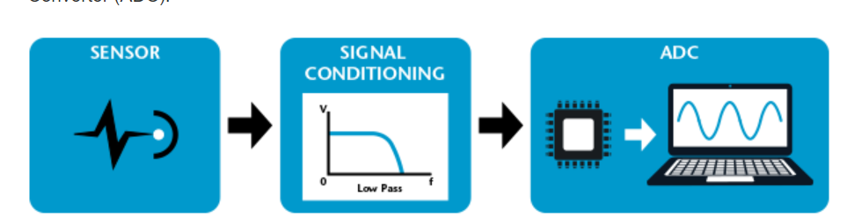
Components of a Data Acquisition System
All data acquisition systems consist of three essential elements
Sensor that convert physical parameters to electrical signals
Signal conditioning circuitry to convert sensor signals into a form that can be converted to digital values.
Analog-to-Digital Converter (ADC), which convert conditioned sensor signals to digital values.

Slide 11
Objective of Data Acquisition
It must acquire the necessary data, at correct speed and at correct time.
It must monitor the complete plant operation to maintain on line and safe operations.
It must be able to collect, summaries and store data for diagnosis of operation and record purpose.
It must be flexible and capable of being expanded for future requirements.
It must be able to compute unit performance indices using on-line, real time data.
It must be reliable, easy to operate and must be user friendly.

Slide 12
REFERENCES
C. R. Balamurugan and D. Periazhaagar Basics of Biomedical Instrumentation. Magnus Publications, Chennai ISBN: 978-81-939626-7-1
Gupta, P.K.. Cytology, Genetics and Molecular Biology, Rastogi Publishers, Meerut, 1993.
Roit I.M., Brostoff J. and Male D. Mosby .Immunology (6 th Edition) by, An imprint of Elsevier Sci Ltd., 2002.
G. Webster , Medical Instrumentation: Application And Design, 3rd edition ,Wiley Publishers
D Reddy, Biomedical Signal Processing, Tata Mcgraw Hill Publications.
Sergio Cerutti Advanced Methods of Biomedical Signal Processing, Oxford Publications.
B. Jacobson, J.G. Webster, Medical and Clinical Engineering, Prentice Hall, International.
Cromwell, Biomedical Instrumentation and Measurements, Prentice Hall, International.
R.S. Khandupur, Handbook of Biomedical Instrumentation, - Tata McGraw Hill
Leslie Cromwell, Fred J. Weibell, Erich A. Pfeiffer, "Biomedical Instrumentation and Measurements", Pearson Education.
https://nptel.ac.in/courses/121/106/121106008/
http://mediatoget.blogspot.in/2012/01/static-dynamic-characteristicsof.htm

Slide 13
THANK YOU

